Slide 1
Physical Quantities and Units
Content
1.1 Physical quantities
1.2 SI Units
1.3 The Avogadro constant
1.4 Scalars and vectors

Slide 2
Base Quantities and SI Base Units
7 base quantities (Only 6 for A level syllabus)
Cannot be expressed in terms of any other physical quantities
Physical Quantity | Symbol | Unit | Symbol
Mass | m | kilogram | kg
Distance | d | metre | m
Time | t | second | s
Current | I | ampere | A
Temperature | θ | kelvin | K
Amount | n | mole | mol
Luminous intensity (*) |  | candela | cd
(*) does not feature on the A-Level course

Slide 3
Derived Quantities and Units
Derived quantities -- a product or a quotient of two or more base quantities
Derived units -- a product or a quotient of two or more base units
Mostly have special names for their units
Quantity | Symbol | Unit | Symbol
Velocity | v | metre per second | ms⁻¹
Acceleration | a | metre per second squared | ms⁻²
Force | F | newton | N
Energy | E | joule | J
Pressure | P | pascal | Pa

Slide 4
How to express a derived unit in terms of base-unit equivalent?
Derived Unit
Defining Equation
Base-Unit Equivalent
Quantity | Word Definition | Defining Equation | Symbol of Unit | Base-Unit Equivalent
Acceleration | Change of velocity per unit time | a = (v – u ) / t | ms⁻² | ms⁻²
Power | Rate of energy spent | P = E/t | W | kg m²s⁻³
Pressure | Force per unit area | P = F/A | Pa | kg m⁻¹s⁻²

Slide 5

Importance of Base Units
To find units of unknown quantities in an equation
Let’s try…
The energy of a photon of light of frequency f is given by hf, where h is the Planck constant. What are the base units of h?
Answer: base units of h = kgm²s⁻¹

Slide 6

Importance of Base Units
To check the homogeneity of a physical equation
Units on LHS = Units on RHS
Homogeneous
Let’s try…
s = ut + $\frac{1}{2}$at²

Slide 7
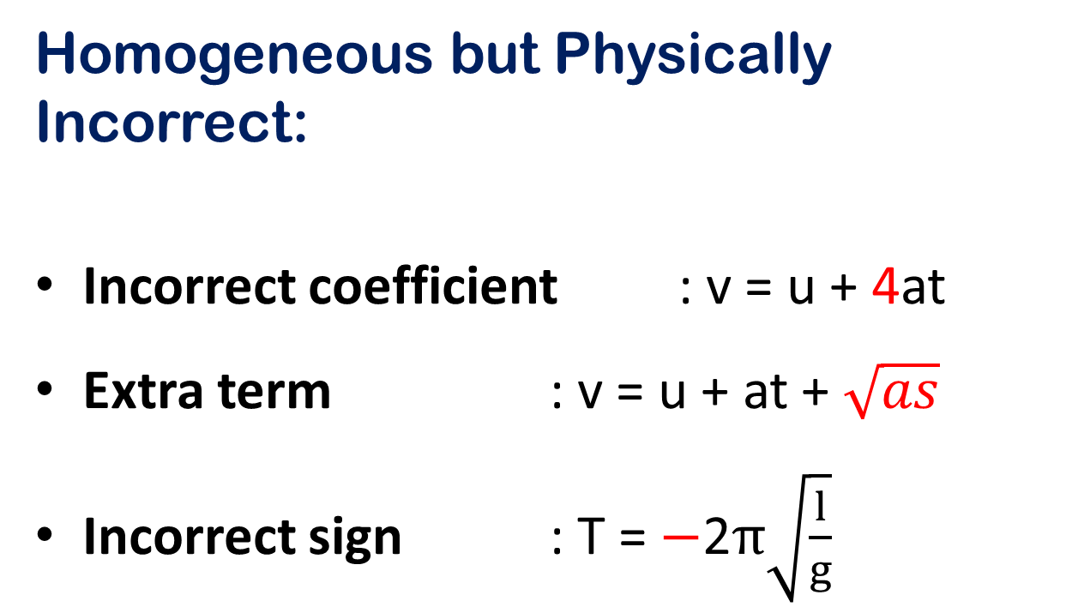
Homogeneous but Physically Incorrect:
Incorrect coefficient : v = u + 4at
Extra term : v = u + at + $\sqrt{as}$
Incorrect sign : T = $−$2$π\sqrt{\frac{l}{g}}$

Slide 8
Prefixes
A more convenient way to write very large or small numbers.

Slide 9
Making Estimation
To make comparison and sensible estimation of the magnitude of physical quantities of things around us.
Examples:
The amount of water we drink from a cup.
The height of a twenty-storey building.
The time to travel to another city 500km away.
The density of water.

Slide 10


Scalars and Vectors
SCALAR
VECTOR
Has magnitude only | Has both magnitude and direction
Eg: mass, distance, speed, time | Eg: force, displacement, velocity
can be added and subtracted directly (algebraically) | added using diagrams (geometrically)

Slide 11
Vector Representation
A vector can be represented with a diagram of a line and an arrow head
magnitude
direction

Slide 12
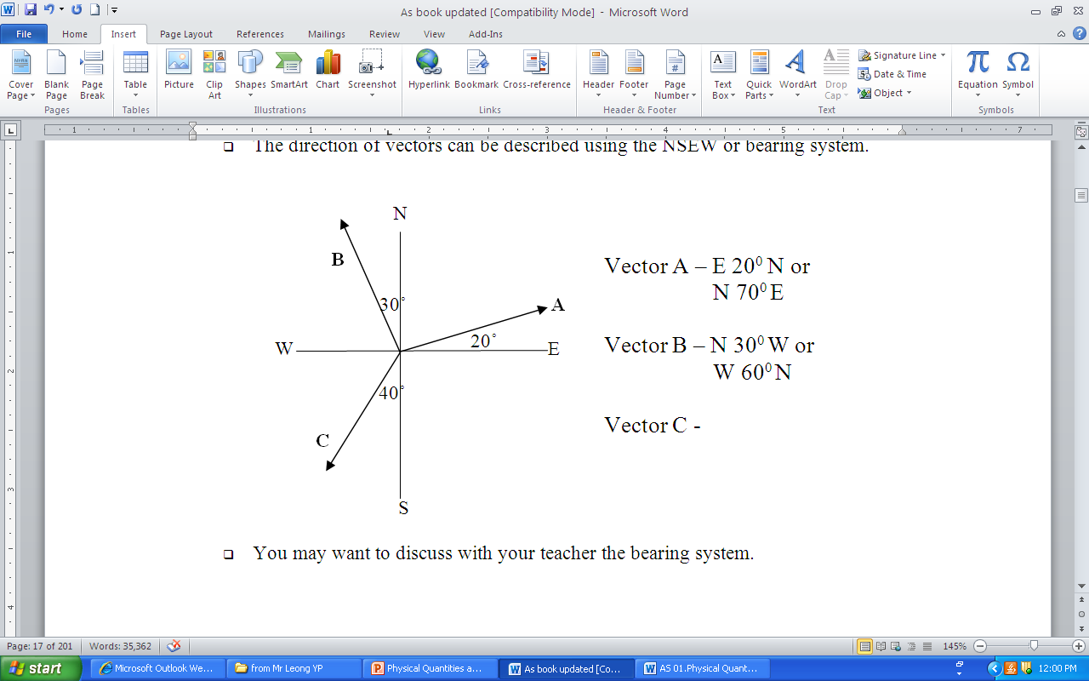
Vector Representation
The direction of vectors can be described using the NSEW or bearing system
Example:

Slide 13
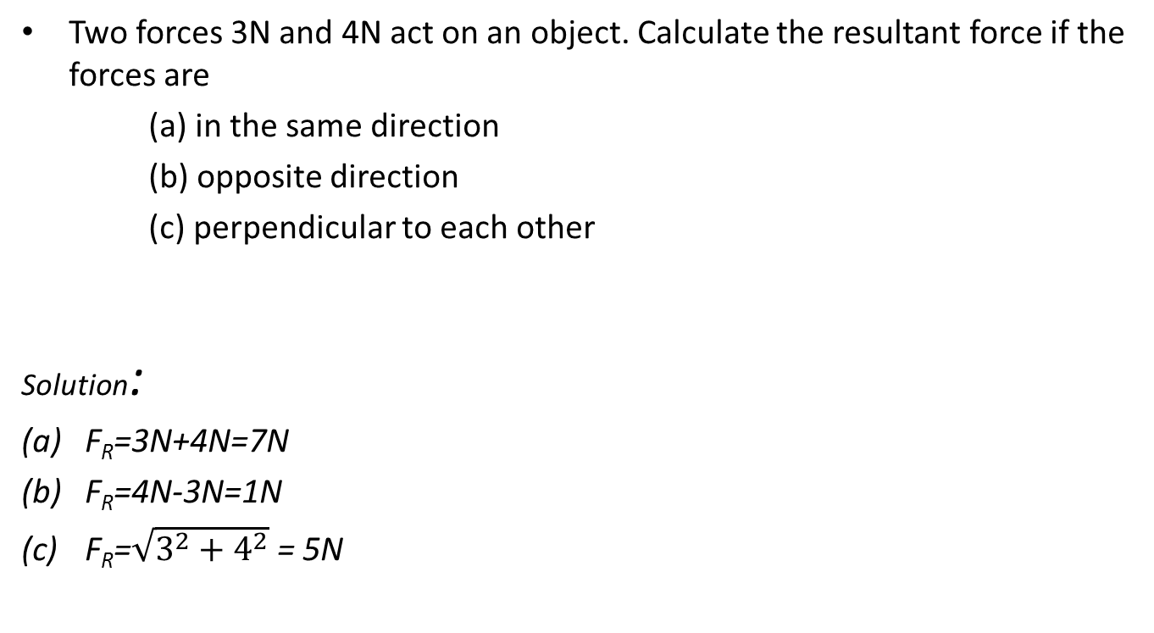
Example 1
Two forces 3N and 4N act on an object. Calculate the resultant force if the forces are
(a) in the same direction
(b) opposite direction
(c) perpendicular to each other
Solution:
F_{R}=3N+4N=7N
F_{R}=4N-3N=1N
F_{R}=$\sqrt{3^{2}+4^{2}}$ = 5N

Slide 14

Example 2
A force 26.5 N in the direction of northeast
What will be the length of this vector ?
What will be the angle it makes with the horizontal?
Can you draw a force 40 N in the direction southwest using the same scale?
A scale of 1cm : 10 N can be used.
The angle can be measured using a protractor.

Slide 15
Resolution
VECTOR OPERATION
Addition
Subtraction
Triangle Method
Parallelogram Method

Slide 16

Drawing Method – Triangle Method
The second vector follows the first
The magnitude of C can be found by measuring the length of C
The angle that C makes with the horizontal can be measured with a protractor
C
C = A + B
B
A

Slide 17

Drawing Method – Parallelogram Method
Both the vectors start from the same point.
Complete the parallelogram
Connect the diagonal that also starts from the same point.
What would it be for B + A??
A
A
C
B
B
C = A + B

Slide 18


Subtraction of Vectors
Let’s try this:
D = A $−$ B
Rewrite the equation:
D = A + ($−$B)
Adding two vectors A and $−$B :
A
B
A
D
-B
What would it be for B $−$ A??

Slide 19
Resolution Method
Any single vector can be represented by two perpendicular vectors (components)
Horizontal
Vertical

Slide 20
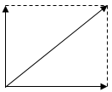
Resolution Method
Velocity v at an angle θ as shown:
Vertical component of v -- vsinθ
Horizontal component of v -- vcosθ
v
vsinθ
θ
vcosθ

Slide 21
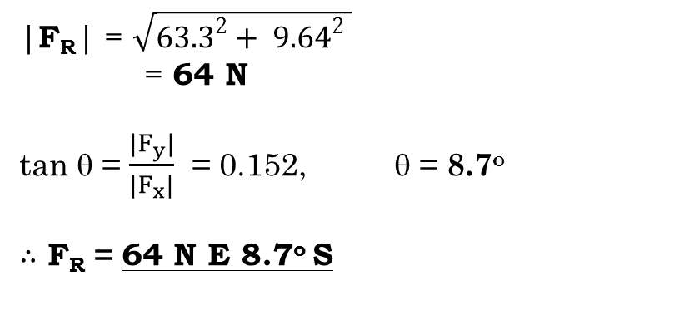
Example 3
Two forces are acting on an object as shown. What is the resultant force?
50N
The resultant horizontal component,
F_{x} = 50 cos 30 + 40 cos 60
= 63.3 N
The resultant vertical component,
F_{y} = 50 sin 30 + (– 40 sin 60)
= – 9.64 N
30º
60º
40N
Combining F_{x} and F_{y} :
|F_{R}| = $\sqrt{{63.3}^{2}+ {9.64}^{2} }$
= 64 N
tan θ = $\frac{{|F}_{y}|}{{|F}_{x}|}$ = 0.152, θ = 8.7º
$∴$ F_{R} = 64 N E 8.7º S
θ
F_{x}
F_{y}
F_{R}

Slide 22
Example 4

Slide 23
Example 5
Find the components parallel to and perpendicular to the inclined line.

